Slide 1
Name: G. ROHINI
NM id: au730321104041
Reg. No: 730321104041
Year: III
Department: B.E Computer science and Engineering
College Name: Builders Engineering College
3/21/2024
Annual Review
1

Slide 2
PROJECT TITLE
EMAIL DETECTION
3/21/2024
Annual Review
2

Slide 3

1. Introduction to Email Detection.
2. Technologies and Tools.
3. Software Development
4. Algorithm.
5. Use Cases and Applications.
6. Conclusion.
AGENDA
3/21/2024
Annual Review
3

Slide 4

PROBLEM STATEMENT
With the exponential growth of email usage for personal and professional communication, the proliferation of spam emails has become a significant issue. Spam emails not only inundate inboxes, causing inconvenience to users, but also pose serious security risks such as phishing attacks, malware distribution, and fraudulent activities.
Key Challenges:
1. Adversarial Techniques
2. Imbalanced Data
3. Contextual Understanding
3/21/2024
Annual Review
4

Slide 5

PROJECT OVERVIEW
Identification of the challenges associated with email detection.
Definition of the specific objectives and goals of the project.
Description of the dataset used for training and testing the email detection model.
Overview of the features extracted from email data for classification.
Evaluation metrics used to assess the performance of the email detection model (e.g., accuracy, precision, recall, F1-score).
Presentation of validation results and verification of model robustness.
3/21/2024
Annual Review
5

Slide 6

WHO ARE THE END USERS?
1. Email Service Providers
2. IT and Security Teams
3. Regulatory Authorities and Compliance Officers
4. End-User Clients and Applications
5. Organizations and Enterprises
3/21/2024
Annual Review
6

Slide 7

YOUR SOLUTION AND ITS VALUE PROPOSITION
Solution:
Stay informed about the latest research and advancements in email security to enhance the effectiveness of the solution.
Value Proposition:
It’s ability to address key pain points associated with email communication, particularly the influx of spam emails, while providing enhanced security, productivity, and user experience.
3/21/2024
Annual Review
7

Slide 8

THE WOW IN YOUR SOLUTION
Transparency and Trust
2. Intelligent Classification
3. Near-Perfect Accuracy
4. Comprehensive Security
5. Seamless Integration
3/21/2024
Annual Review
8

Slide 9
MODELLING
Email detection involves building a predictive model that can effectively distinguish between spam and legitimate (ham) emails based on various features extracted from the email content, headers, and metadata.
Data Collection and Preprocessing
Feature Engineering
Model Training
Model Evaluation
Continuous Improvement
3/21/2024
Annual Review
9

Slide 10
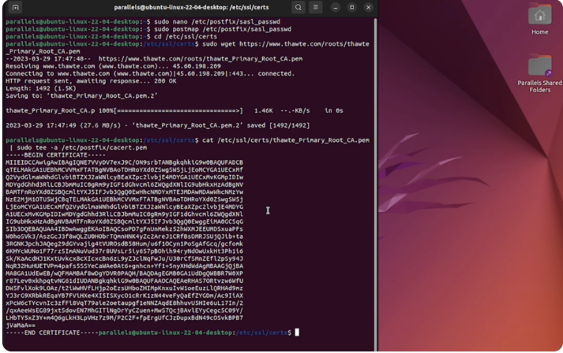
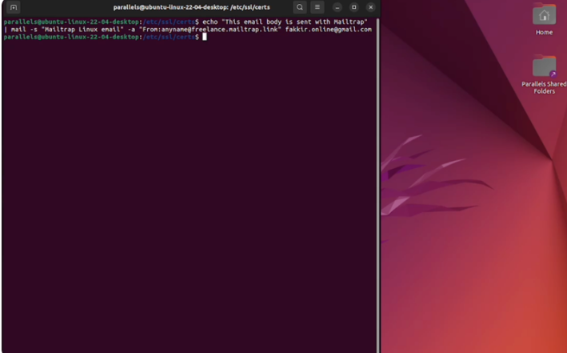
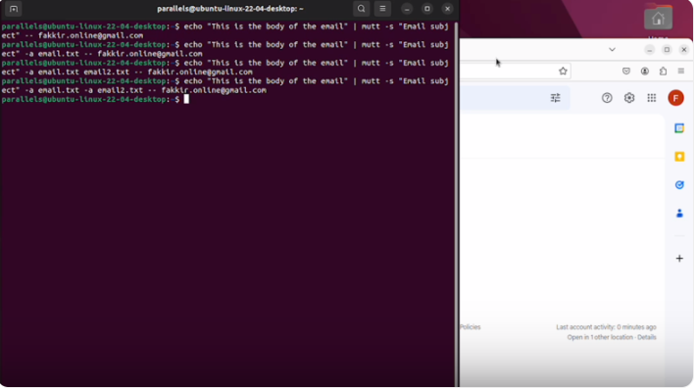
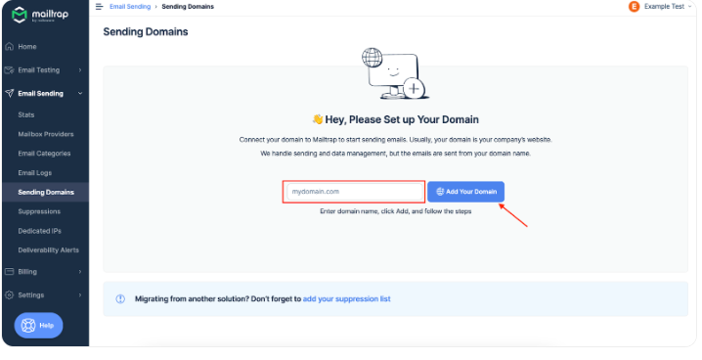
RESULTS
3/21/2024
Annual Review

